Slide 1


Neural coding of binaural cues between acoustic and electrical stimulation in an animal model of single-sided deafness
Poster #8
Yoojin Chung, Bertrand Delgutte
Eaton-Peabody Laboratories, Mass Eye & Ear
Harvard Medical School
Notes:
Hello, my name is Yoojin and I am from Eaton Peabody Labs. My poster, poster #8, about neural coding of …

Slide 2
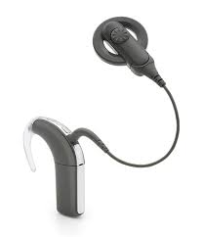
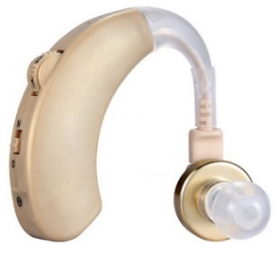
Combined electric and acoustic hearing
Bimodal hearing: residual hearing in non-implanted ear
Cochlear implant (CI) as a treatment for single-sided deafness (SSD)
Benefit of listening with two ears for bimodal listeners:
Complimentary benefit of having different type of information
Binaural redundancy & head shadow effect
→ Not true binaural processing
Sensitivity to binaural cues in bimodal hearing in laboratory settings (Francart et al., 2009; 2011)
Notes:
Cochlear implants have been widely successful as a treatment for deafness and more and more people who have residual hearing receive cochlear implants. When the the residual hearing is in the non-implanted ear it is called bimodal hearing. These group of CI users continue to use hearing aid in the non-implanted ear for additional benefits. Recently, CI as been emerging as a treatment for single-sided deafness as well. Most of the binaural benefit in bimodal listeners is based on binaural redundancy (the ability to receive the same information in both ears), and the head shadow effect, which allows listeners to focus on the ear with a better signal-to-noise.

Slide 3
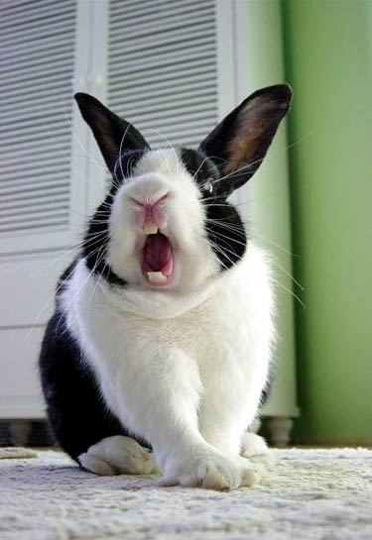
Rabbit model of single-sided deafness and cochlear implant (SSD-CI)
Unilateral deafening and implantation in one adult rabbit.
Unanesthetized recordings from single neurons in Inferior Colliculus (IC)
Stimuli
Acoustic clicks in NH ear and electric pulse trains in deafened/implanted ear at low rates (20 - 80Hz).
Mismatch between acoustic and electric delays
Electric stimulation: directly stimulates the auditory nerve.
Acoustic stimulation: frequency dependent delay of 1-5 ms primarily due to cochlear traveling wave delay.

Slide 4
Auditory midbrain neurons show binaural interaction between electrical pulses and acoustic clicks

Slide 5
Neural coding of binaural cues between acoustic and electrical stimulation in an animal model of single-sided deafness
Poster #8

